Slide 1
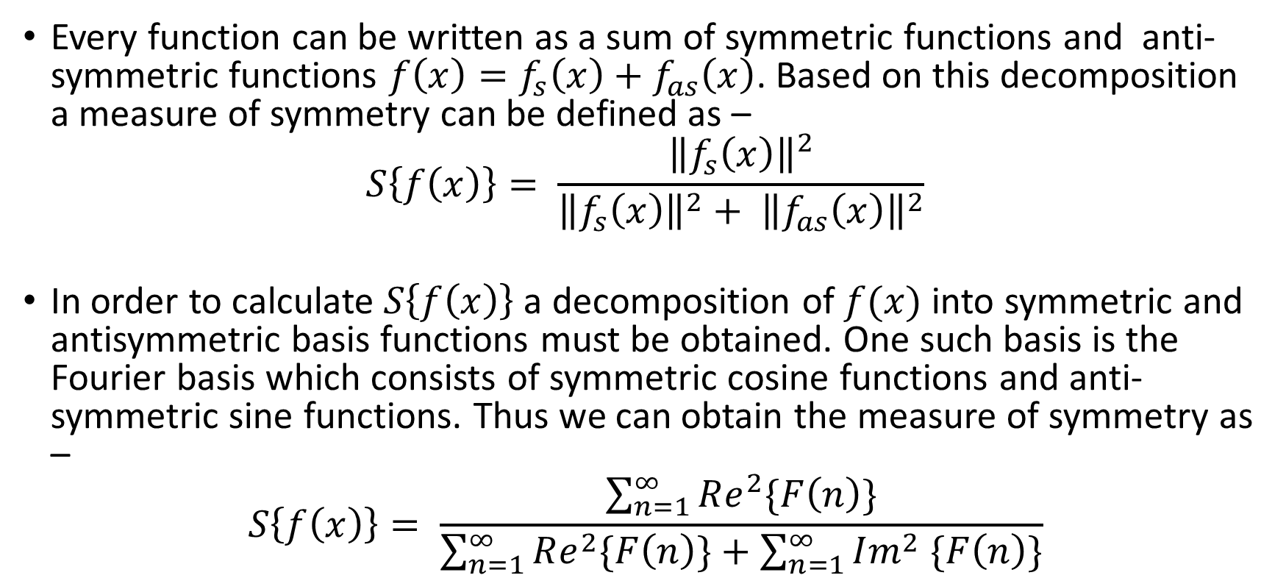
Robust Reflectional Symmetry Metric
Every function can be written as a sum of symmetric functions and anti-symmetric functions $f\left(x\right)=f_{s}\left(x\right)+f_{as}\left(x\right)$. Based on this decomposition a measure of symmetry can be defined as –
$$S\left\{f\left(x\right)\right\}= \frac{{\left\|f_{s}\left(x\right)\right\|}^{2}}{{\left\|f_{s}\left(x\right)\right\|}^{2}+ {\left\|f_{as}\left(x\right)\right\|}^{2}}$$
In order to calculate $S\left\{f\left(x\right)\right\}$ a decomposition of $f(x)$ into symmetric and antisymmetric basis functions must be obtained. One such basis is the Fourier basis which consists of symmetric cosine functions and anti-symmetric sine functions. Thus we can obtain the measure of symmetry as –
$$S\left\{f\left(x\right)\right\}= \frac{\sum_{n=1}^{∞}{Re^{2}\{F\left(n\right)\}}}{\sum_{n=1}^{∞}{Re^{2}\{F\left(n\right)\}}+\sum_{n=1}^{∞}{Im^{2} \{F\left(n\right)\}}}$$

Slide 2
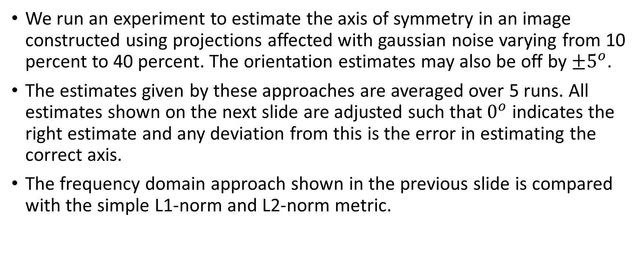
Robust Reflectional Symmetry Metric
We run an experiment to estimate the axis of symmetry in an image constructed using projections affected with gaussian noise varying from 10 percent to 40 percent. The orientation estimates may also be off by $±5^{o}$.
The estimates given by these approaches are averaged over 5 runs. All estimates shown on the next slide are adjusted such that $0^{o}$ indicates the right estimate and any deviation from this is the error in estimating the correct axis.
The frequency domain approach shown in the previous slide is compared with the simple L1-norm and L2-norm metric.

Slide 3
Comparison of metrics

Slide 4
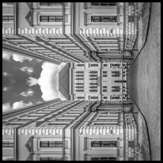

Symmetry prior in Tomographic reconstruction
Experiment:
20000 projections
180 clusters
40 percent noise
To explicitly demonstrate the benefit of including a symmetric prior, we run two refinement algorithms on the initialization provided by HLCC – one with symmetric prior and one without. The results are shown on the next page.
Original Image 1
Original Image 2

Slide 5
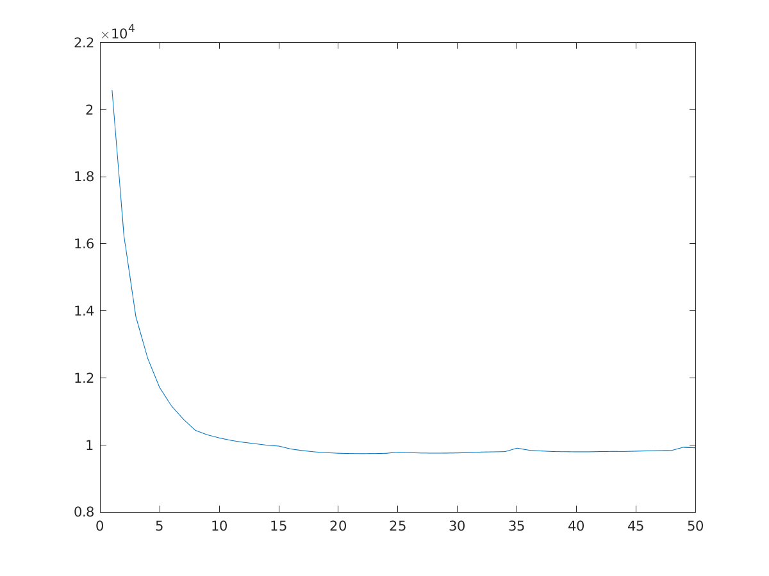
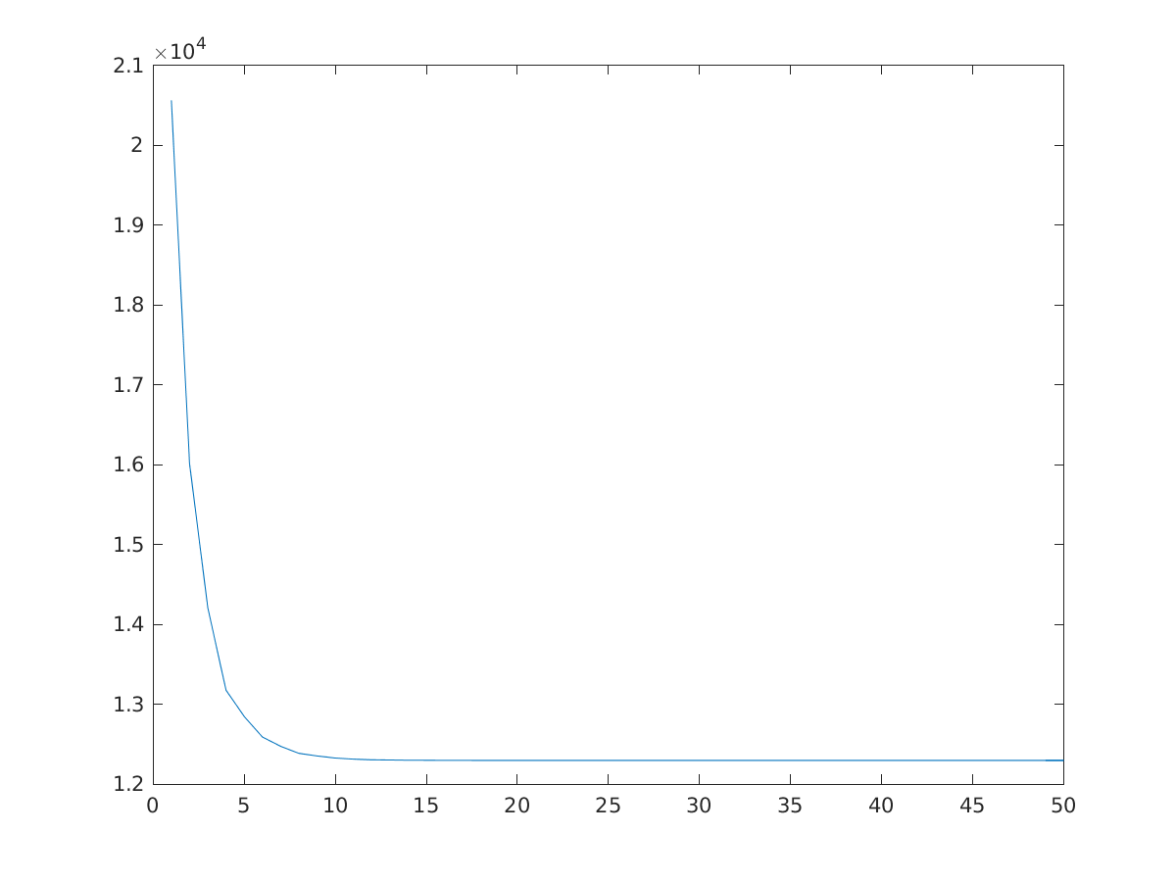
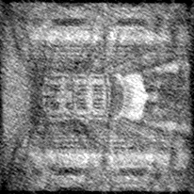
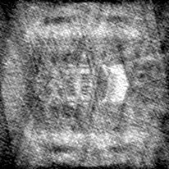
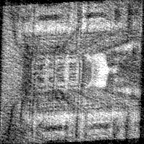
Relative reconstruction error
Refinement without using symmetry | 13.19%
Refinement using symmetry | 8.55%
Refinement using symmetry
Non-symmetric convergence
Refinement without using symmetry
Estimate returned by HLCC
Symmetric convergence

Slide 6
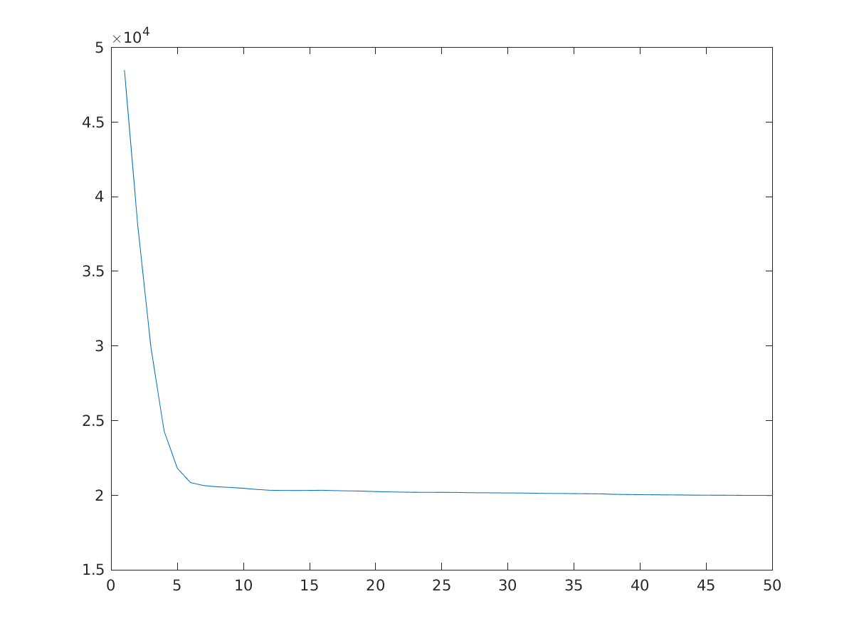
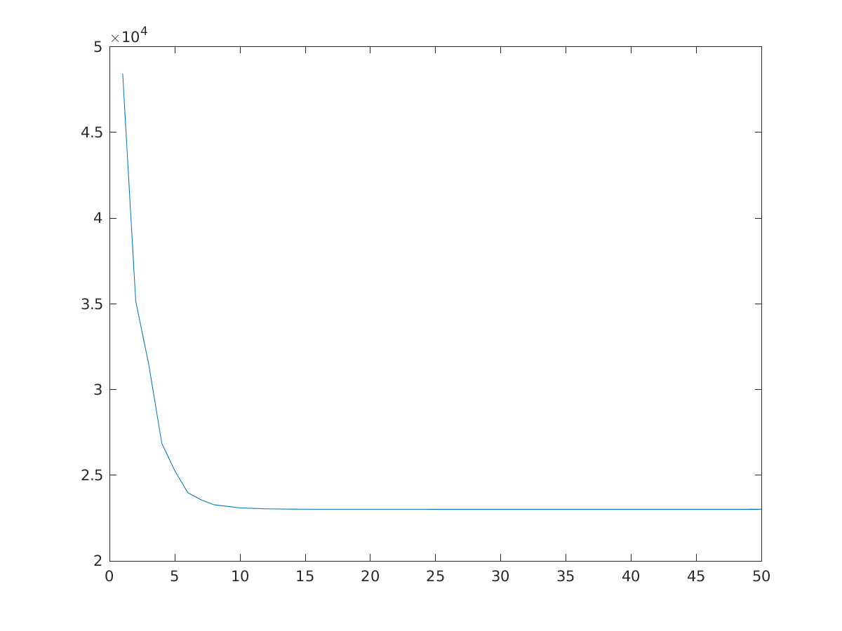
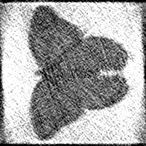
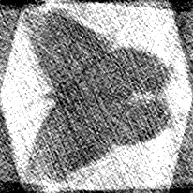
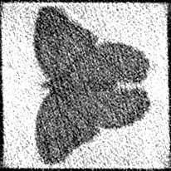
Relative reconstruction error
Refinement without using symmetry | 12.87%
Refinement using symmetry | 8.10%
Refinement using symmetry
Non-symmetric convergence
Refinement without using symmetry
Estimate returned by HLCC
Symmetric convergence

